Slide 1

PERSONALISED MEDICINE RECOMMENDATION SYSTEM
NAME – MAYANK CHOUHAN
COURSE – B.TECH CSE
ROLL NO – 2118777(73)
SEM/SEC – V/D

Slide 2
PERSONALISED MEDICINE RECOMMENDATION SYSTEM CONTENTS
INTRODUCTION TO AI/ML
DATA RECOMMENDATION AND VISUALISATION
PURPOSE OF MEDICINE RECOMMENDATION SYSTEM
DATASET AND ITS VISUALIZATION
LANGUAGES USED
DIFFERENT LIBRARIES USED
APPLICATION
FUTURE AIMS
CONCLUSION

Slide 3
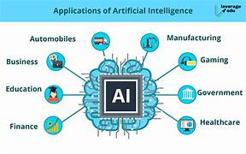
INTRODUCTION TO AI/ML
ARTIFICIAL INTELLIGENCE(AI): refers to the development of computer system that can perform tasks that typically require human intelligence. It includes learning, reasoning, problem-solving, perception, natural language understanding, and even creativity. The goal of AI is to create machines that can mimic cognitive functions associated with human minds.
Machine Learning(ML): Machine Learning is a subset of AI that focuses on developing algorithms and statistical models that enable computers to improve their performance on a task over time without explicit programming. It involves the use of data to train models and make predictions or decisions.

Slide 4
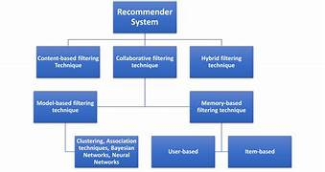
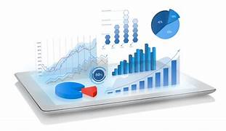
DATA RECOMMENDATION
DATA RECOMMENDATION: A recommendation system is a specific application of data science that focuses on predicting or suggesting items that a user may be interested in, based on their past behavior, preferences, or similarities with other users.
DATA VISUALISATION: Data visualization is the graphical representation of information to uncover patterns, trends, and insights. Utilizing charts, graphs, and maps, it simplifies complex datasets, making it easier for users to comprehend and analyze data, facilitating informed decision-making in various fields, from business analytics to scientific research.

Slide 5
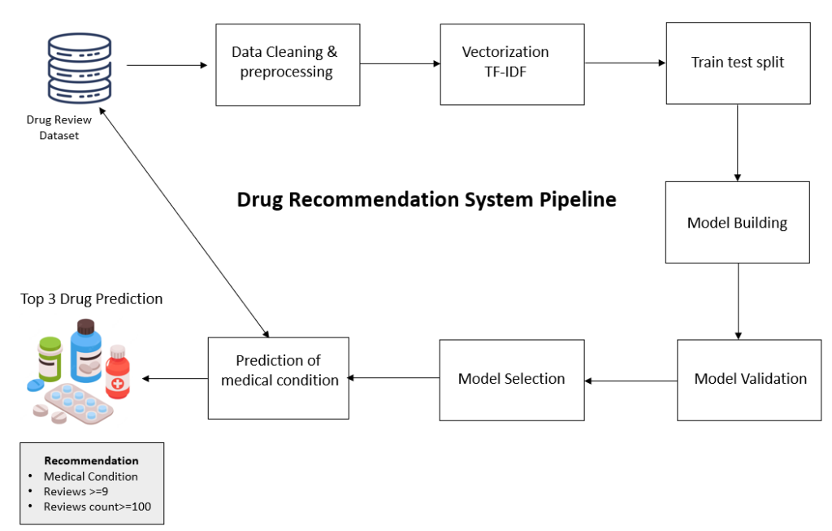
PURPOSE OF MEDICINE RECOMMENDATION SYSTEM
The Medicine Recommendation System developed aimed at providing personalized and targeted medication recommendations for individuals based on their unique health profiles. This system seamlessly integrates two distinct datasets to enhance the precision and relevance of its recommendations.
The primary objective of this system is to bridge the gap between medical data and patient needs, offering tailored medication suggestions that align with individual health conditions, preferences, and potential interactions, promoting medication adherence, minimizing adverse effects, and ultimately contributing to improved patient outcomes.

Slide 6
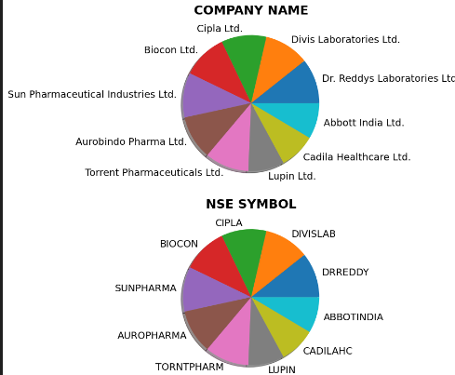
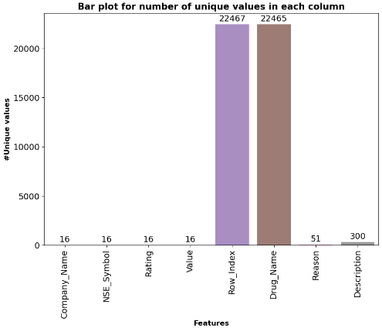
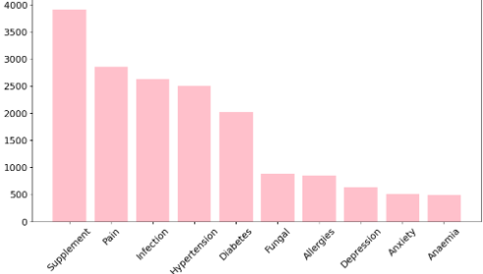
DATASET 1: RangeIndex: 241 entries, 0 to 240 0 Gender 241 non-null object 1 Symptoms241non-null object 2 Causes 241 non-null object 3 Disease 241 non-null object 4 Medicine 241non-null object
DATASET AND ITS VISUALISATION
DATASET 2:
RangeIndex: 22481 entries, 0 to 22480
0 Company_Name 22481 non-null object
1 NSE_Symbol 22481 non-null object
2 Rating 22481 non-null object
3 Value 22481 non-null float64
4 Row_Index 22481 non-null int64
5 Drug_Name 22481 non-null object
6 Reason 22481 non-null object
7 Description 22467 non-null object

Slide 7
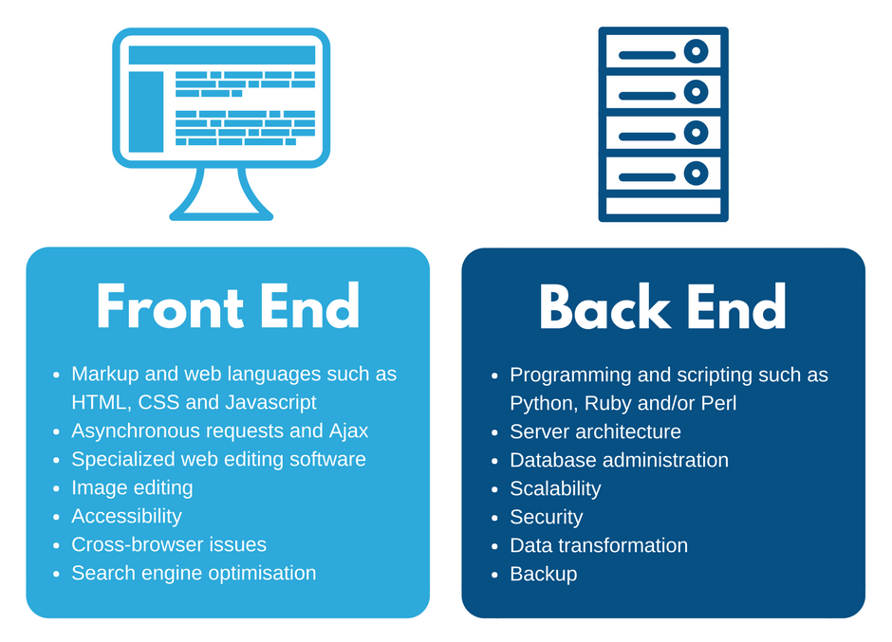
LANGUAGED USED
Python: Python is a interpreted programming language used for data analysis, web development, scientific computing, artificial intelligence, and automation. It offers a wide range of modules and functions for different tasks. It allows for quick development and prototyping.
Jupyter Notebook: is an open-source web application that allows to create and share live code, equations, visualizations, and explanatory text. Used in data analysis, machine learning, scientific computing, and supports multiple programming languages, including Python, R, Julia, and more.
HTML (Hypertext Markup Language): HTML is the standard markup language used to create and design the structure of a web page. It consists of various elements and tags that define the different parts of a webpage, such as headings, paragraphs, images, links, and more.

Slide 8
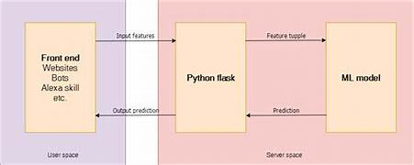
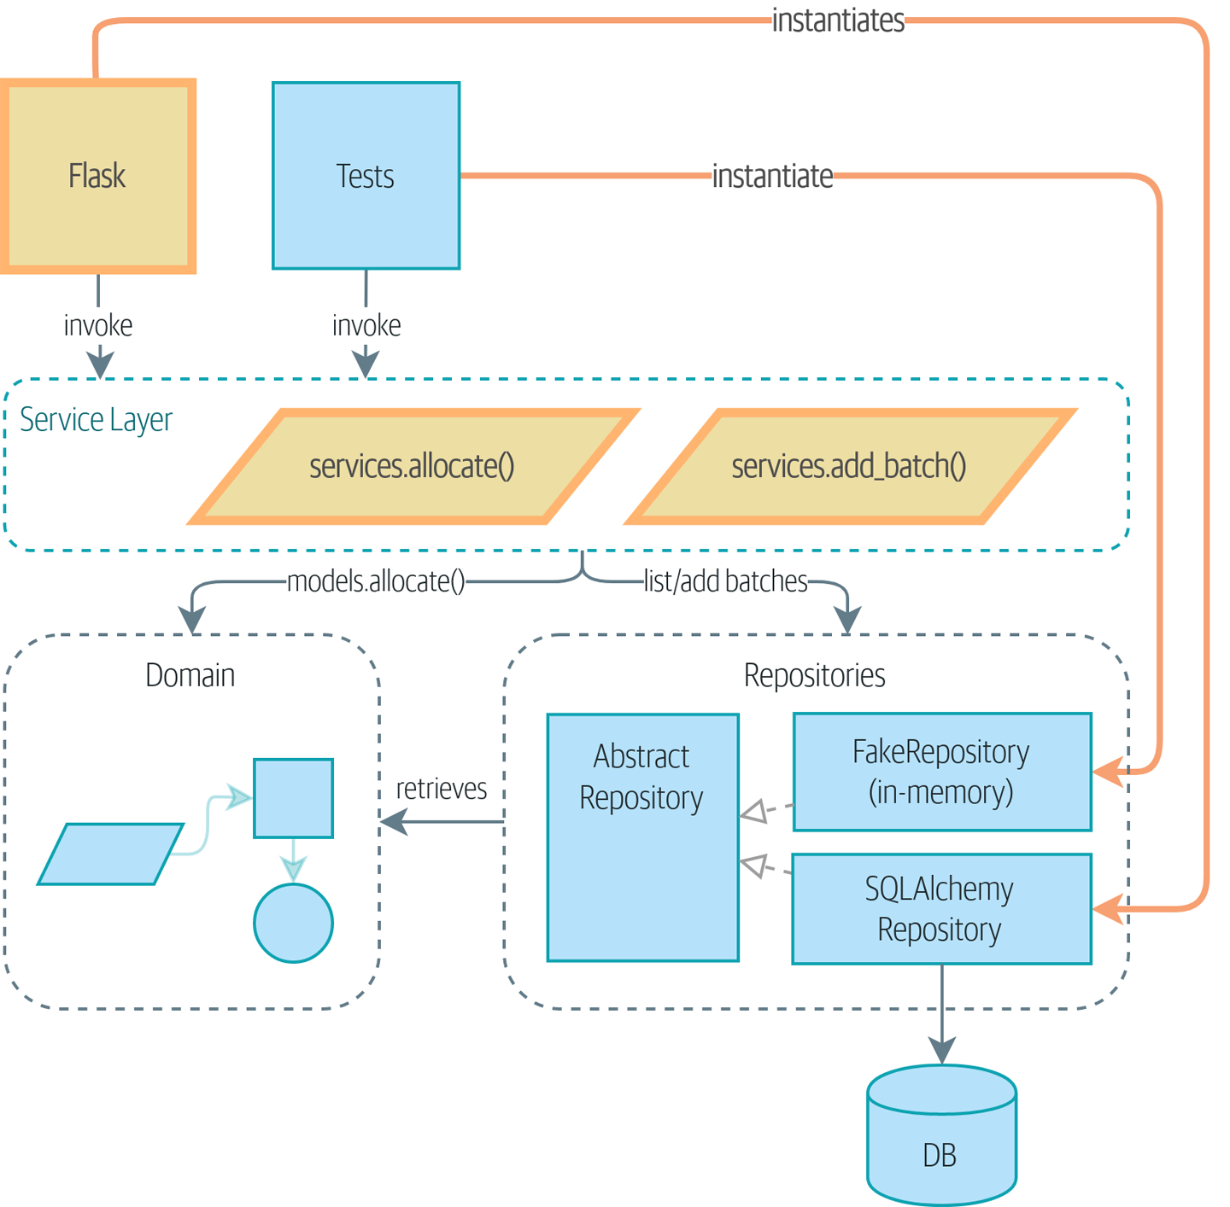
LANGUAGES USED
CSS (Cascading Style Sheets): CSS is a stylesheet language that controls presentation and layout of HTML documents such as colors, fonts, spacing, and positioning, create visually appealing and consistent designs.
JavaScript: is a scripting language that enables the creation of dynamic and interactive content on web pages. It allows developers to manipulate the Document Object Model (DOM), handle events, and perform actions based on user interactions.
Flask: Flask is a lightweight web framework written in Python. It's designed to be simple, flexible, and easy to use for building web applications and APIs. Flask follows the WSGI (Web Server Gateway Interface) standard, and it comes with built-in support for Jinja2 templating, making it easy to create dynamic and interactive web pages.
Oracle Database: Oracle Database is a widely used, enterprise-class relational database management system (RDBMS) developed by Oracle Corporation. It provides a comprehensive and scalable platform for storing, managing, and retrieving data efficiently. Oracle Database supports both SQL and PL/SQL, offering a robust environment for building and deploying database-driven applications.

Slide 9
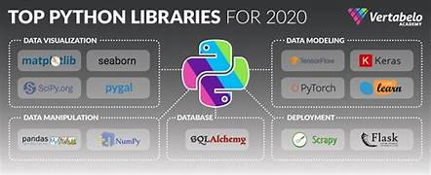
LIBRARIES USED
1. Pandas: Data manipulation and analysis.
2. NumPy: Numerical computing.
3. Matplotlib.pyplot: Data visualization.
4. Wordcloud:Generating word clouds.
5. Seaborn: Statistical data visualization.
6. Math: Mathematical functions.
7. Scikit-learn (sklearn.feature_extraction.text): Machine learning.
8. TfidfVectorizer: Text feature extraction.
9. Cosine Similarity: Measuring similarity between vectors.
10. Sklearn.metrics.pairwise: Pairwise metrics.
11. PrettyTable: Creating tables.
12. Flask: Web framework for building web applications and APIs in Python.
13. flash: Part of Flask for flashing messages to the user.
14. render_template: Function in Flask for rendering HTML templates.
15. request: Part of Flask for handling HTTP requests.
16. redirect: Part of Flask for redirecting to another endpoint or URL.
17. url_for: Part of Flask for generating URLs for specific endpoints.
18. cx_Oracle: Python extension module that enables access to Oracle Database.
19. jsonify: Part of Flask for creating JSON responses.
20. flask_cors: Flask extension for handling Cross-Origin Resource Sharing (CORS).

Slide 10
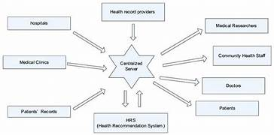
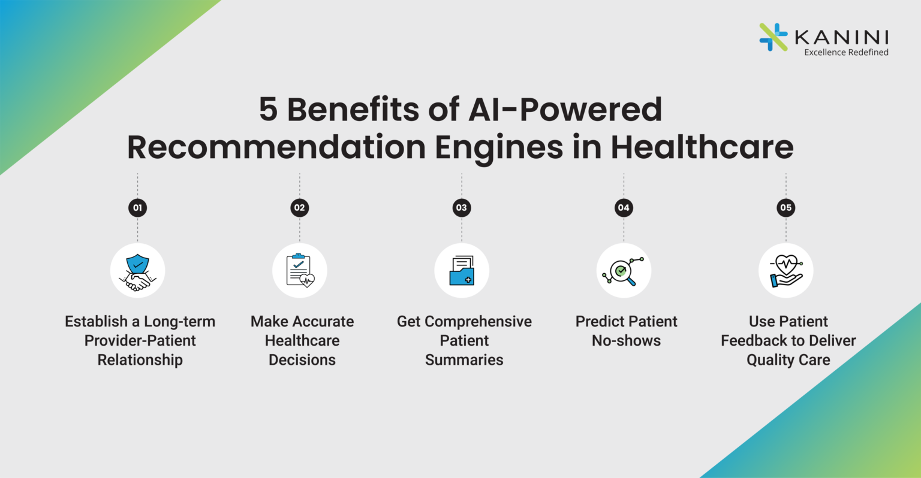
APPLICATION OF MEDICINE RECOMMENDATION SYSTEM
1. Optimized Medication Regimens
2. Adherence Improvement
3. Minimization of Adverse Effects
4. Disease Prevention and Management
5. Holistic Health Approach
6. Efficient Health Data Utilization
7. Cross-Referencing Symptoms and Medications
8. User-Friendly Health Information Retrieval
9. Collaboration with Healthcare Professionals
10. Educational Resource

Slide 11
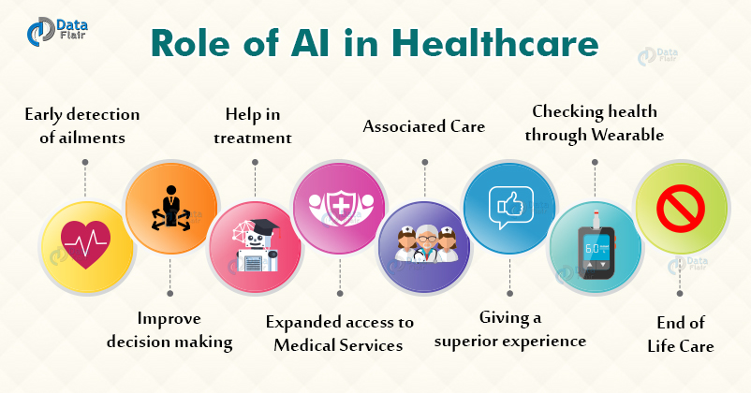
FUTURE SCOPE
1. Enhanced Personalization
2. Adaptability to Evolving Medical Knowledge
3. Integration of Real-time Patient Data
4. Collaboration with Healthcare Providers.
5. User Interface Enhancements
6. Expansion of Database
7. Integration with Telemedicine Platforms

Slide 12
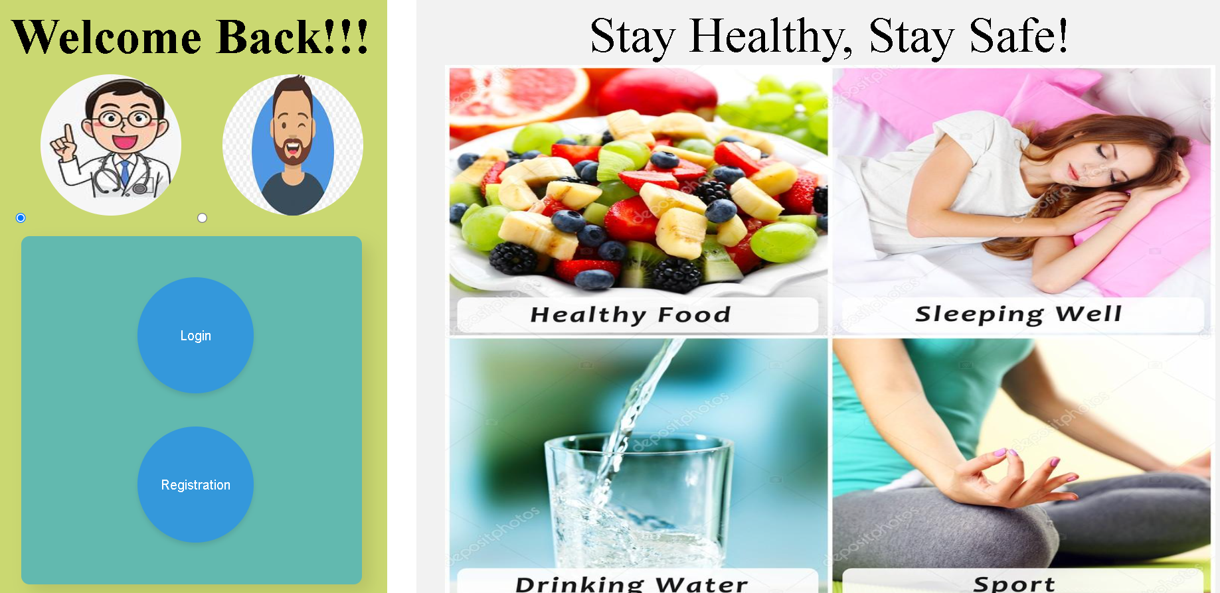
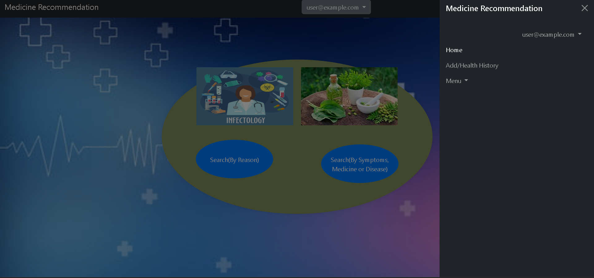
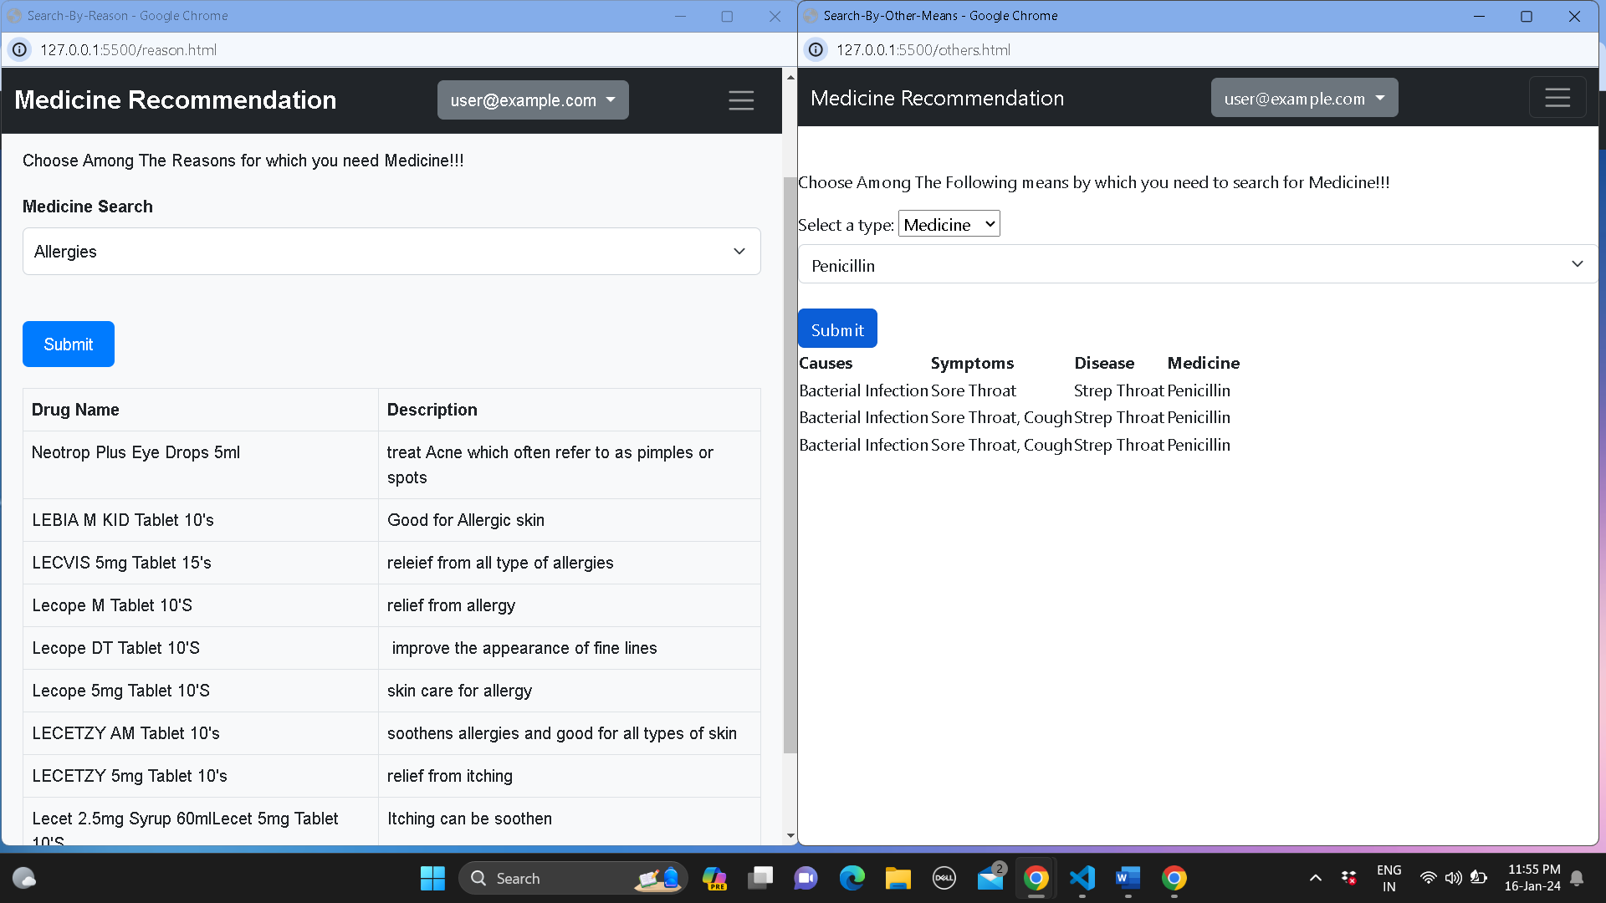
INTERFACE

Slide 13
CONCLUSION
In conclusion, the Medicine Recommendation System, powered by advanced technologies and frameworks, epitomizes the fusion of AI, machine learning, and web development for personalized healthcare. Integrating Flask, HTML, and JavaScript, the system seamlessly deploys on a user-friendly web interface. Leveraging Pandas, NumPy, and Scikit-learn, it provides precise medication recommendations from diverse datasets. Oracle Database ensures secure data management. Future goals include heightened personalization and adaptability to evolving medical knowledge. The system's deployment reflects a commitment to a seamless user experience. Positioned at the intersection of technology and healthcare, this innovative solution marks a significant stride toward a future where medical decisions are tailored, efficient, and increasingly patient-centric.

